Slide 1
ARREST-TB
RESULTS OF PRE-PROCESSING AND SEGMENTATION TECHNIQUES

Slide 2
RESULTS : First Code
number of dots in the image 21
number of dots in the image 19
number of dots in the image 23
4
number of dots in the image 19
number of dots in the image 18
number of dots in the image 23
7
number of dots in the image 22
8
number of dots in the image 23
9
number of dots in the image 30
10
number of dots in the image 41
11

Slide 3
RESULTS : First Code
number of dots in the image 36
12
number of dots in the image 19
number of dots in the image 15
number of dots in the image 9
number of dots in the image 15
number of dots in the image 22
17
number of dots in the image 13
number of dots in the image 8
number of dots in the image 21
number of dots in the image 19
number of dots in the image 25
22
number of dots in the image 23
23

Slide 4
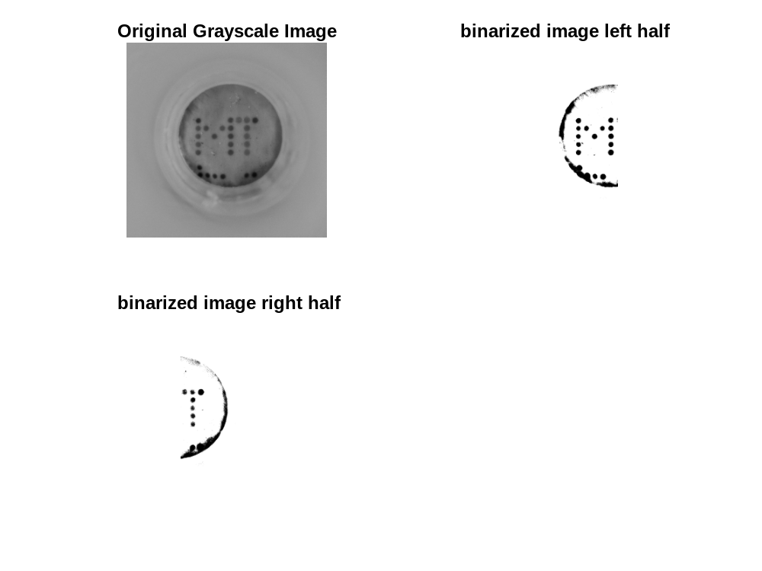
RESULTS : Second Code
Number of nonzero elements in the left binarized image= 2823383
Number of zero elements in the left binarized image= 111727
Number of nonzero elements in the right binarized image= 2353450
Number of zero elements in the left binarized image= 581660

Slide 5
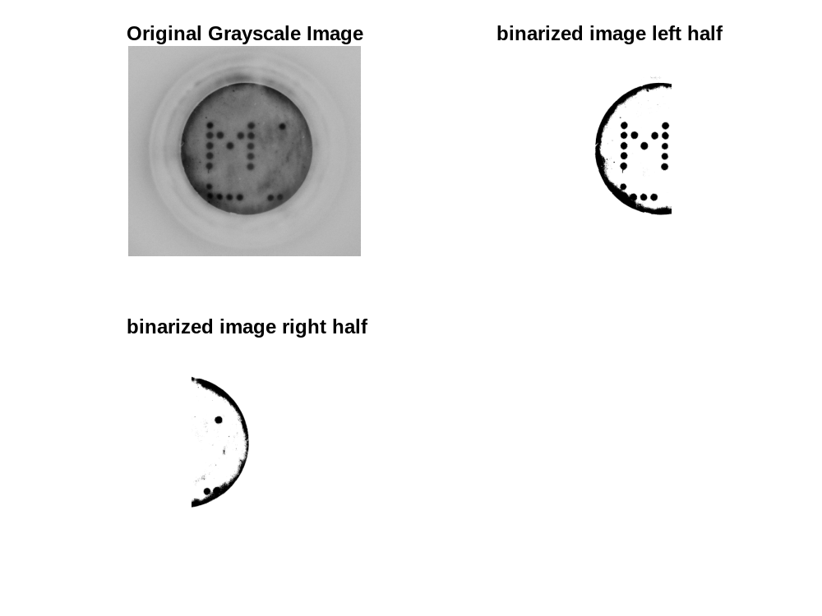
RESULTS : Second Code
Number of nonzero elements in the left binarized image= 1693324
Number of zero elements in the left binarized image= 132392
Number of nonzero elements in the right binarized image= 1424893
Number of zero elements in the left binarized image= 400823

Slide 6
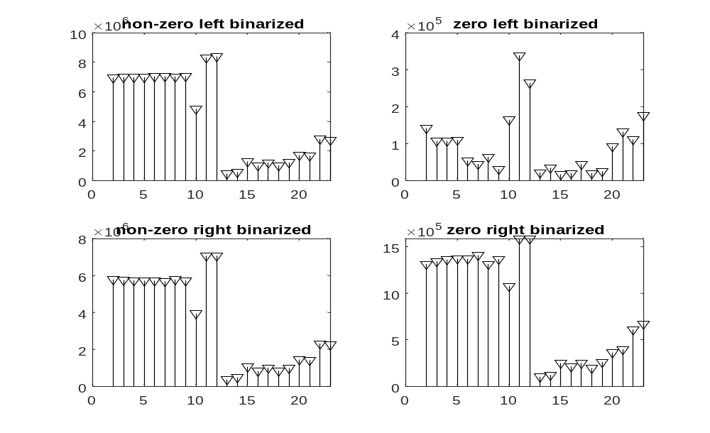
RESULTS : Second code
The right corner plot of the plot of the zeros of every image with the image number.

