Slide 1
C4.4X Large: Intel Xeon E5-2666 v3 RAM:30GB Cores:16 ,2.9GHz
C4.8X Large: Intel Xeon E5-2666 v3 RAM: 60GB Cores: 36, 2.9 GHz
M4.4X Large: Intel Xeon® E5-2676 v3 processors RAM: 64GB Cores:16, 2.4 GHz
Comparison Chart for Computation Speed in Various Machines
Machine | Time for 10000 frames before optimizing code | Time for 10000 frames after optimizing code | Cost per hour (USD)
C4.4x LARGE | 756.966 secs = 12.6161 mins | 466.833 secs =7.78 minutes | 0.838
C4.8X LARGE | 816.76 secs = 13.61 mins | 419 seconds =6.98 minutes | 1.675
M4.4X LARGE | 845.56 secs = 14.09 mins | 520.86 seconds =8.681 minutes | 0.958

Slide 2
Machine Instance Description
C4- Compute-optimized instances.
Featuring the highest performing processors and the lowest price/compute performance in EC2.
Use Case
  High performance front-end fleets,
  Web-servers,
Batch processing,
Distributed analytics,
High performance science and engineering applications
M4- General Purpose Instances.
This family provides a balance of compute, memory, and network resources.
Use Case
Small and mid-size databases,
Data processing tasks that require additional memory,

Slide 3
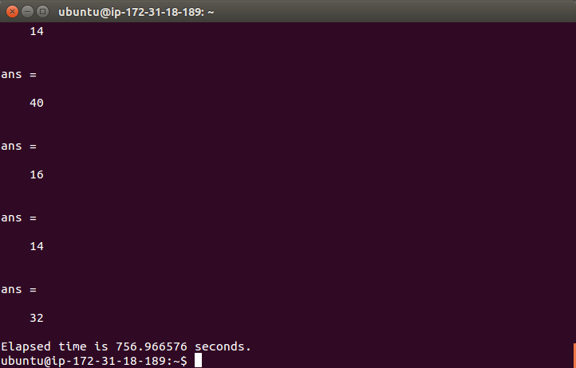
Non-optimized code execution on C4.4X Large

Slide 4

Non-optimized code execution on C4.8X Large

Slide 5
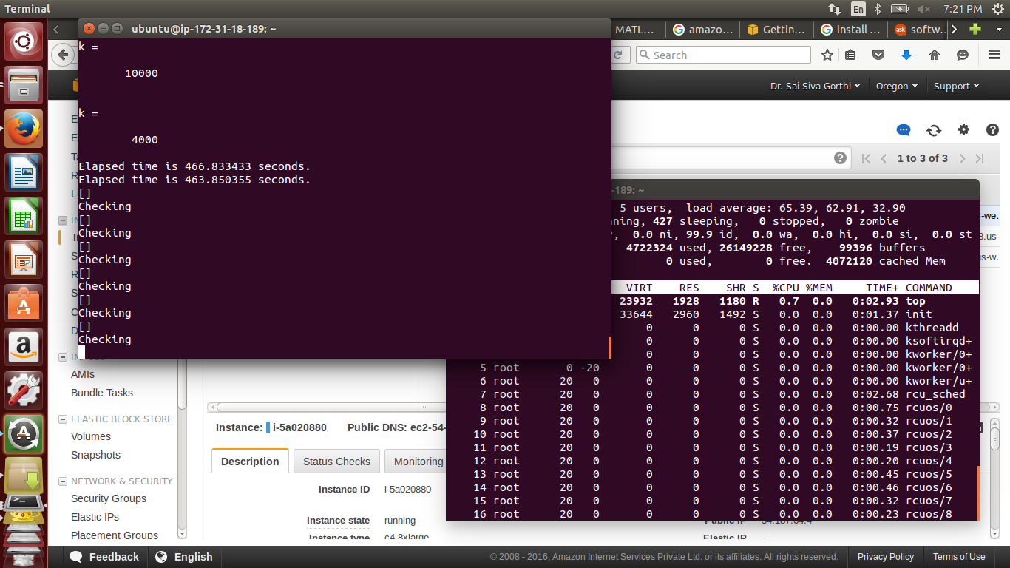
Optimized Code on C4.4X Large

Slide 6
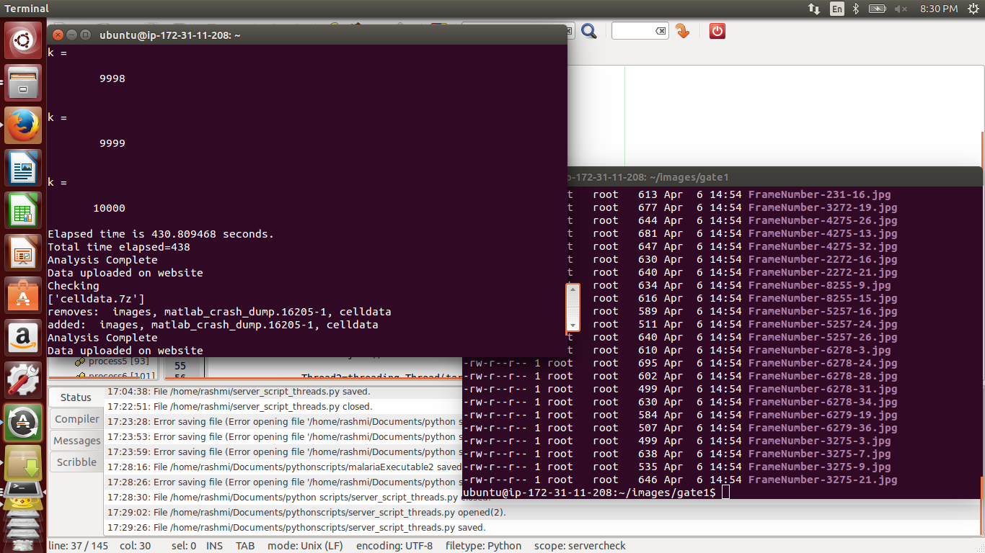
Optimized Code on C4.8X Large

